Slide 1
Copilot Advanced Debugging Features

Slide 2
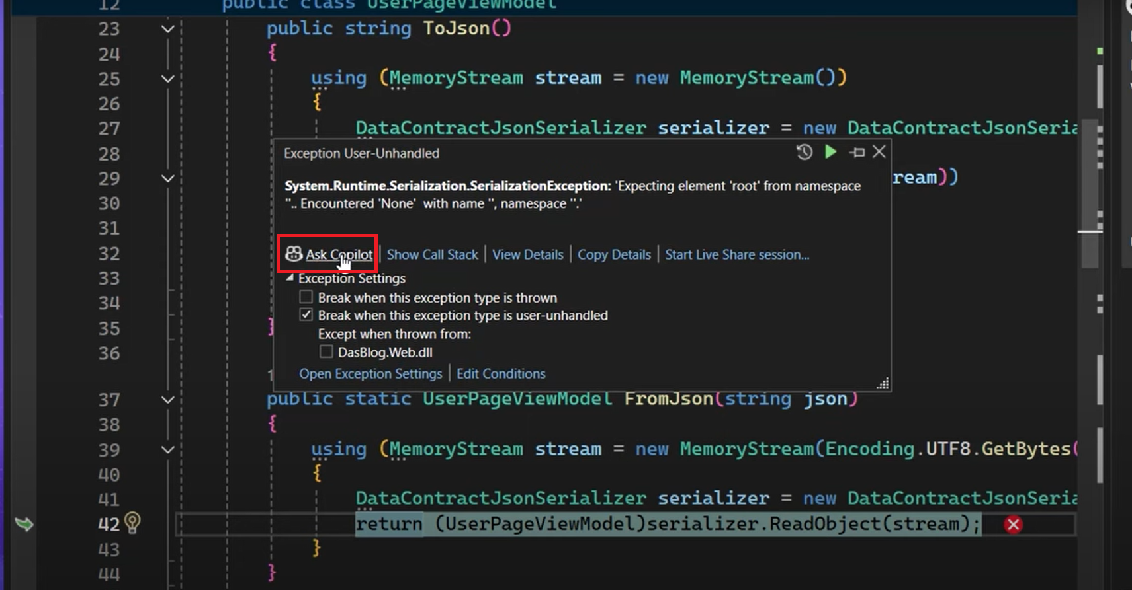
Copilot for Debugging

Slide 3
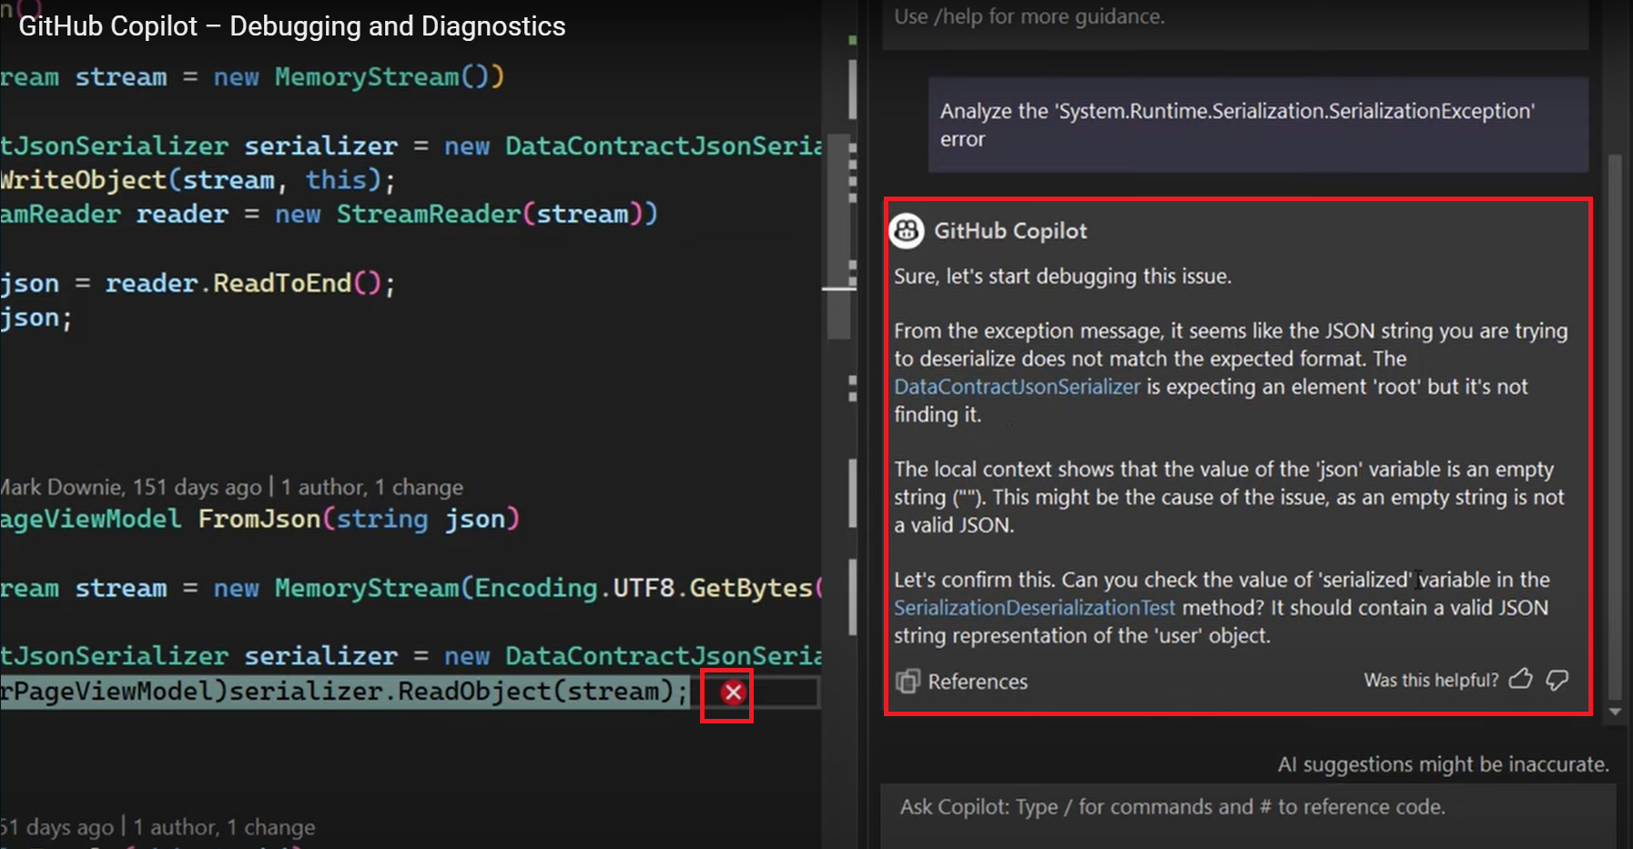
Copilot for Debugging

Slide 4
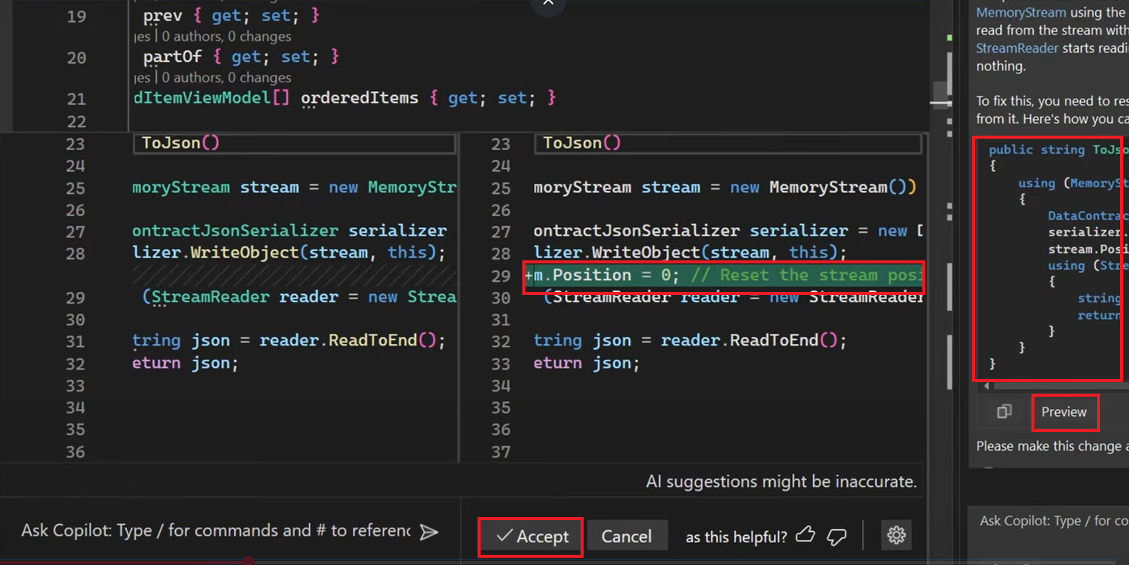
Copilot for Debugging

Slide 5
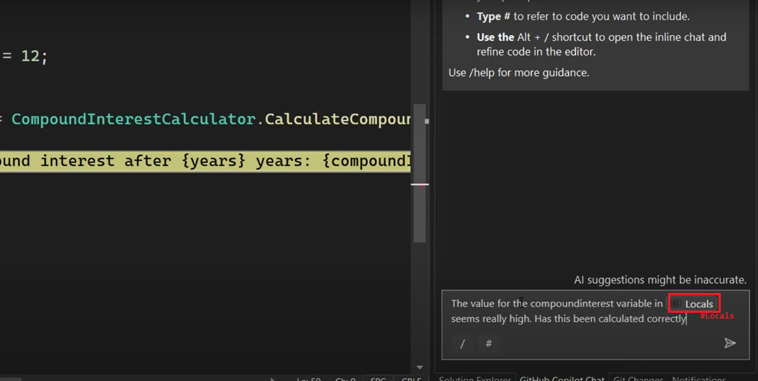
Copilot Local Variable Ref

Slide 6
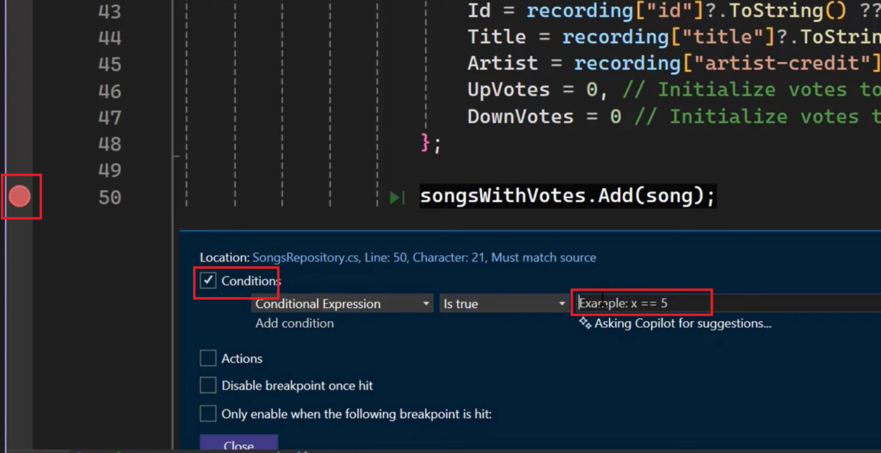
Copilot Conditional Break Point Suggestions

Slide 7
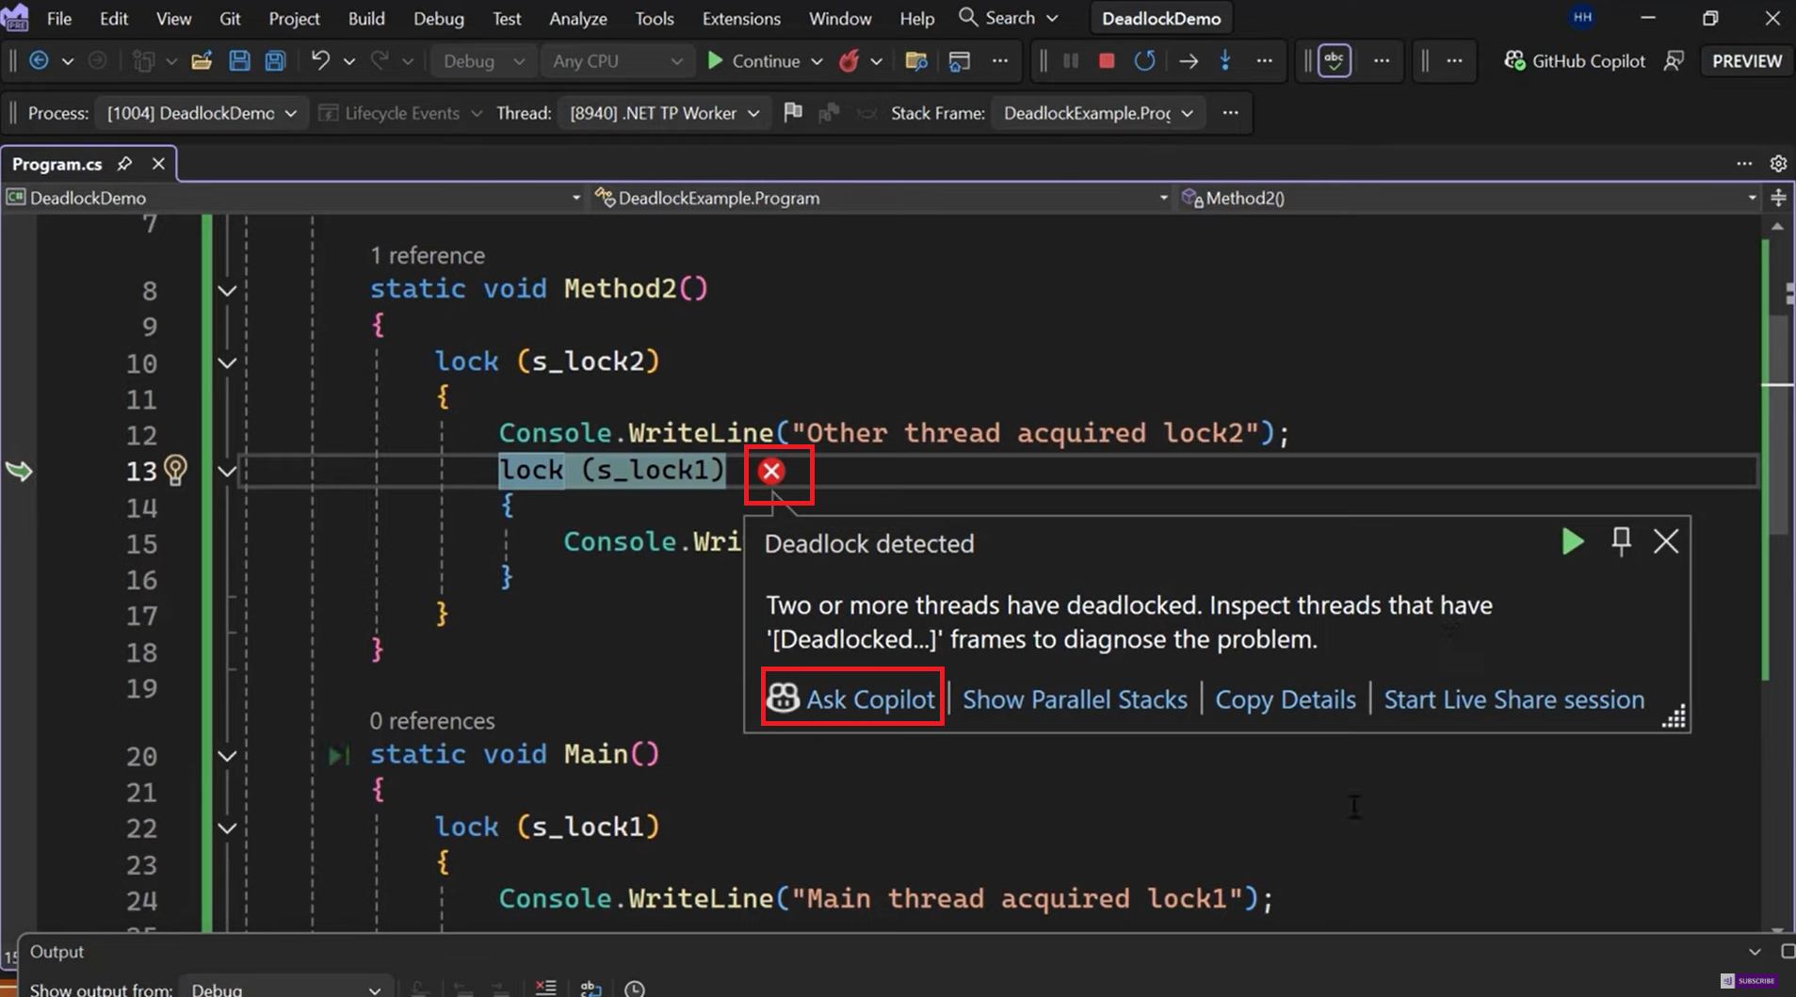
Copilot Error Fixing & Suggestions

Slide 8
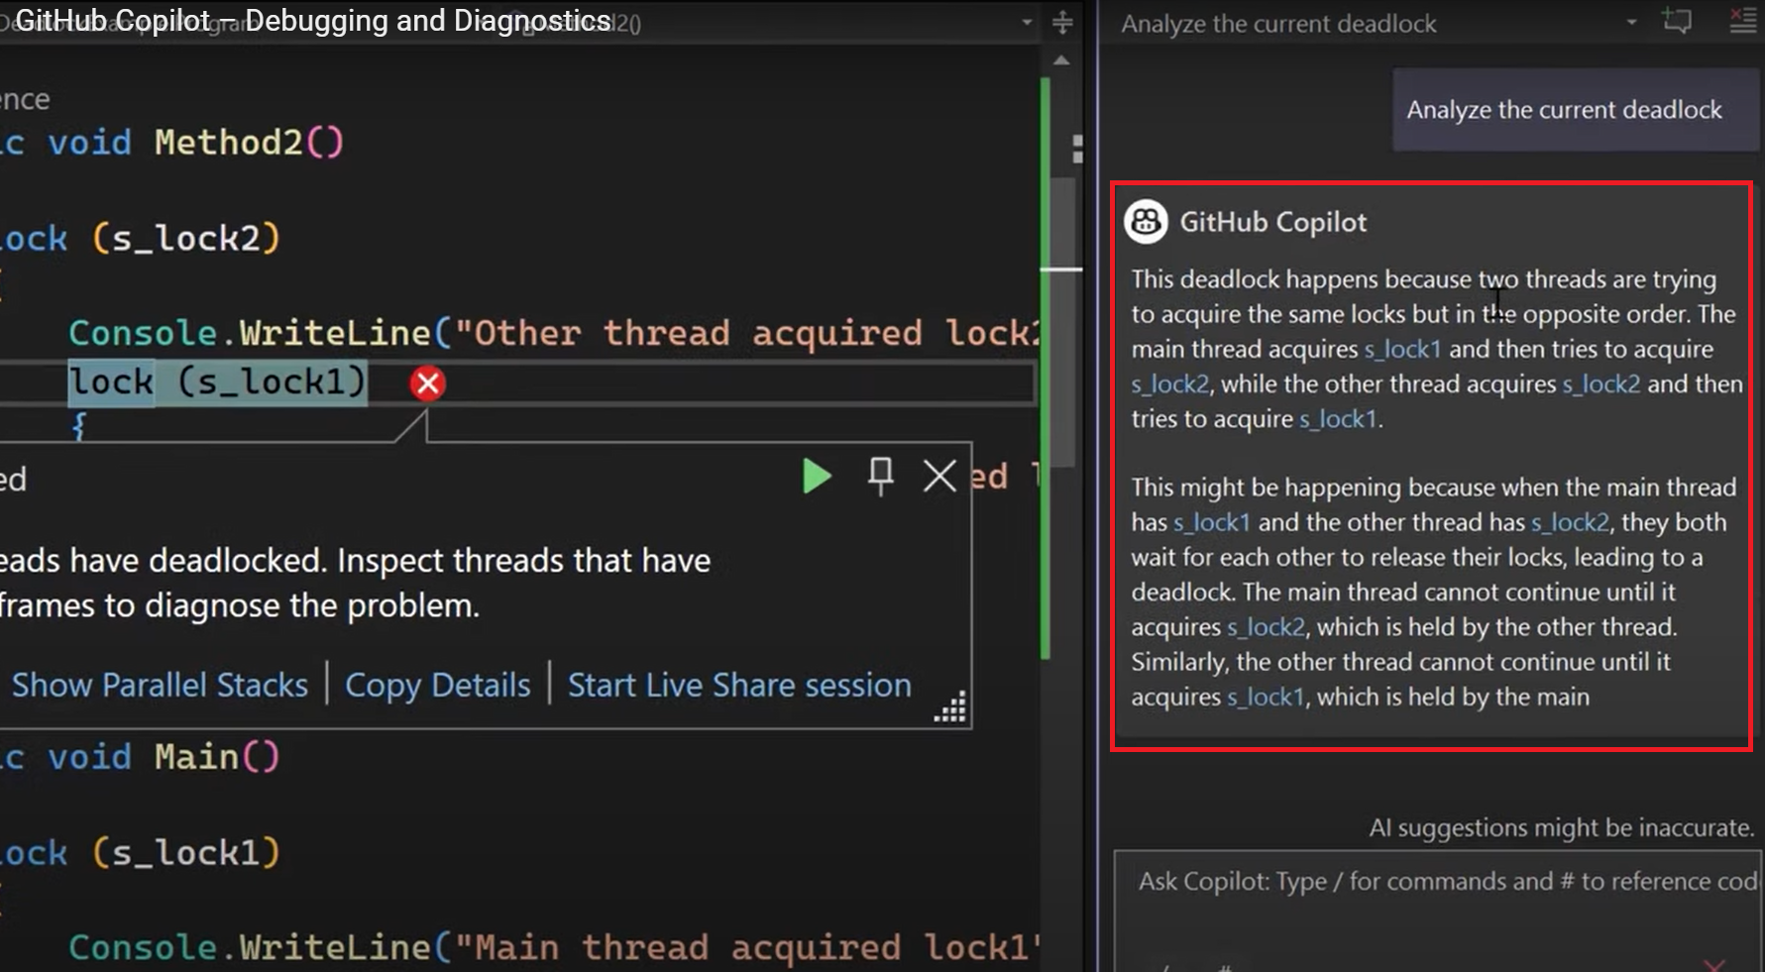
Copilot Analyzing Code based on Errors

Slide 9
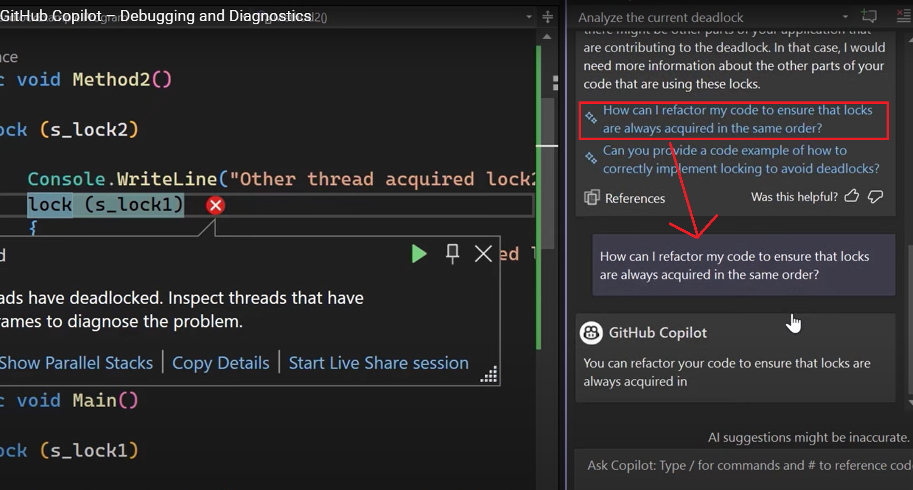
Copilot Prompt Suggestions for Fixing Issues

